Slide 1
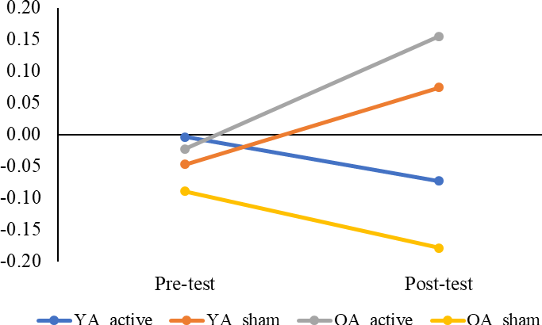
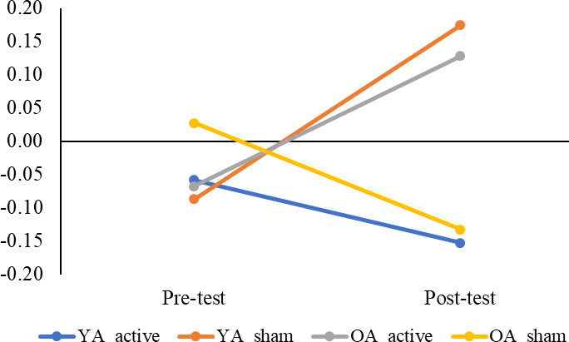
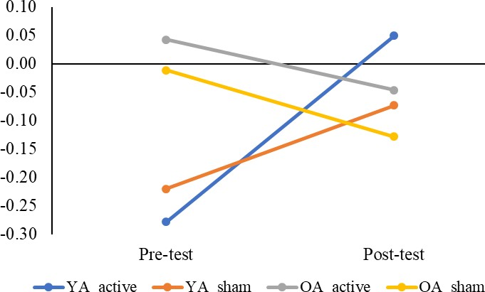
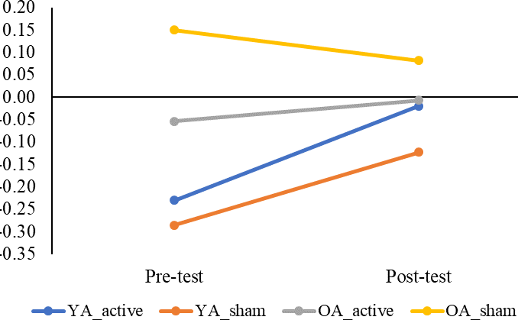
Effect of electrical stimulation on brain activity and reaction time in young and older adults
Phong Yen Wen*, Aisha Islam, Diego Orcioli Da Silva, Dr Annette Pantall
Student ID: 170734837, Email: y.w.phong2@newcastle.edu.my, Course: Bachelor of Medicine and Surgery (MBBS)
1) Introduction
Equipment used
Difference in oxyhaemoglobin levels (au)
fNIRS for left and right Prefrontal Cortex (PFC) during SRT test
*
With age, attention and thinking processes often become slower⁽¹⁾.
A possibly helpful intervention is a non-invasive application of very low electricity known as transcranial Direct Current Stimulation (tDCS) on specific areas of the brain (cortex) associated with attention and movement⁽²⁾.
However, it is not known if this alters brain activity and how this may relate to changes in attention and thinking processes.
SRT requires the participant to press the button as quickly as possible whenever an arrow is shown on screen. CRT requires the participant to press the right or left button depending on the direction of the arrow on screen.
Difference in oxyhaemoglobin levels (au)
*
Figure 1: SRT/CRT device
2) Aims Assess the effect of electrical stimulation (tDCS) on brain activity in young and older adults Assess changes in attentional processing following stimulation
3) Methodology
Participant characteristics _{Average Young Old} * Montreal Cognitive Assessment (MoCA) is a screening tool for early ^{Age (years) 20.1 68.5} memory and thinking problems BMI (kg/m²) 22.0 25.2 (mild cognitive impairment). A score _{Sex (M,F) 3, 19 7,8} of <26 indicates mild cognitive impairment. MoCA* 28.7 27.9 Table 1: Average characteristics of participants Procedure Participants complete questionnaires and screening tests to evaluate their cognitive function. This research is approved by Newcastle University ethics committee. Young and older participants are each divided into groups that are either receiving active tDCS or non-active (sham) tDCS. (Table 2) Participants carry out simple and choice reaction test (SRT & CRT) (Figure 1) while wearing a cap containing sensors from Functional Near Infra-Red Spectroscopy (fNIRS) (Figure 2). Participants are given 20 minutes of active or non-active (sham) tDCS (Figure 3). Repeat simple and choice reaction test while fNIRS device records brain activity.
fNIRS calculates brain activity by measuring the level of oxygenated haemoglobin.
Figure 6 : Difference in oxyhaemoglobin levels between young adults (YA) and older adults (OA) before (pre-test) and after tDCS (post-test). Right panel: Right PFC. Left panel: Left PFC.
fNIRS for left and right Prefrontal Cortex (PFC) during CRT test
*
Figure 2 : Participant wearing fNIRS
Difference in oxyghaemoglobin levels (au)
A very weak current is delivered to specific areas of the brain via electrodes.
Difference in oxyhaemoglobin levels (au)
Figure 3: tDCS electrodes & device
Data Analysis
Statistical analysis is carried out for the 4 groups to determine if there are any significant differences.
Number of participant in each group | SRT & CRT | fNIRS
Young + active | 12 | 4
Young + sham | 10 | 6
Old + active | 9 | 5
Old + sham | 6 | 4
Figure 7 : Difference in oxyhaemoglobin levels between young adults (YA) and older adults (OA) before (pre-test) and after tDCS (post-test). Right panel: Right PFC. Left panel: Left PFC.
Older adults receiving active tDCS displayed significant increase in right and left PFC activity while performing the simple reaction test. (Fig 6)
Young adults receiving active tDCS displayed significant increase in left PFC activity while performing the choice reaction test. (Fig 7)
Results indicate that there is an increased activity in different parts of the cortex following
active tDCS depending on the task carried out.
Due to limited time and materials, a small subsample of participants are analysed (Table 1). With more data it is likely that greater statistical power will be achieved.
Table 2: Number of participants in 4 different groups
4) Results & Discussion
Simple Reaction Test (SRT)
Older adults displayed significant increase in sham- tDCS, implying that reaction time declined less when active tDCS was applied during SRT (Fig 4).
500
SRT (ms)
400
*
300
200
YA active YA sham OA active OA sham
5) Conclusion
Results indicate that electrical stimulation (tDCS) may improve reaction time in older adults
Active tDCS may be an effective intervention to maintain alertness through increase in brain (cortical) activity especially in older adults
Pre Post
Figure 4 : Average reaction time of young adults (YA) and older adults (OA) for the SRT in milliseconds
Choice Reaction Test (CRT) •
*
500
CRT time is greater than SRT time as it is requires more complex thinking. (Fig 5)
CRT time is greater for older adults than younger adults. (Fig 5)
There is no change following active tDCS for younger and older adults. (Fig 5)
CRT (ms)
References
Beurskens R, Helmich I, Rein R, Bock O. Age-related changes in prefrontal activity during walking in dual-task situations: A fNIRS study. International Journal of Psychophysiology 2014;92:122-8.
Kaminski E, Steele CJ, Hoff M, Gundlach C, Rjosk V, Sehm B, et al. Transcranial direct current stimulation (tDCS) over primary motor cortex leg area promotes dynamic balance task performance. International Federation of Clinical Neurophysiology 2016;127:2455-62.
Acknowledgements
Thank you to Dr Annette Pantall for agreeing to have me as a summer student, and to Aisha Islam for her guidance throughout the project. Special thanks to NIHR Newcastle Biomedical Research Centre for funding this project through the Summer Vacation Scholarship.
400
300
200
YA active YA sham OA active OA sham
Pre Post
Figure 5 : Average reaction time of young adults (YA) and older adults (OA) for the CRT in milliseconds

